Slide 1

Final Project
AIT – 580
Crime Analysis in San Francisco City
Satyam Singh
G01389368

Slide 2
Introduction
The Data set I have chosen is the Incident report from Jan 2018 till October 2022 for the city of San Francisco. It contains all the crimes and incidents occurred during this period.
It is created and maintained by the official body of the Police department so it can be trusted.
This dataset has a lot of variables on which analysis can be performed. We can get insightful information which can be helpful for students , working professionals and all sorts of people residing in the city.
The data has 659000 records and 34 columns. This is a good amount of data through which we can answer many questions.
The analysis can benefit many people by spreading awareness of the crimes being committed in their neighborhood and giving them a count of each crime.
Official bodies such as the Police department and the government can also derive conclusions which will benefit the people under their jurisdiction.

Slide 3
Research Questions
What day has the greatest number of crimes committed?
Which is the most common type of crime?
Unsolved cases are the most under which category of crime?
Finding out answers to these questions can help us understand the crime statistic of a city. The answers to these questions will help us realize the current problems going on in a city.
Before stepping outside people can take precautionary measures which would make citizens more alert and in turn decrease the crime rate in a city.
These questions will make us more aware about the situation in our neighbourhood and would make us think twice before taking a hasty decision.
Knowing the type of crime will be useful as then we can try to eliminate it on many levels. Like the government can organize seminars and provide opportunities which can reduce the count.
Along with that, the citizens can prepare themselves to protect themselves from the most committed crime which will also reduce its number.

Slide 4
methods
We have used R, Python and MySQL to perform all the necessary transformations and visualizations. Using Open-source languages provides us with a benefit of having many libraries through which we can perform complicated functions in 2 lines of code.
In all 3 languages we start off by first importing the dataset and then cleaning process.
In data Cleaning we first analyse the important variables needed and then drop the ones we do not require to reduce the complexity of the data.
We check for missing values and find out their total percent in comparison to the total no of rows.
After data is cleaned, we can start our EDA i.e., Exploratory Data Analysis.
In python and R, we can plot several diagrams and graphs which can help us visualize tabular data. As data is easily understood by visualization, this step is important for analysis.
In python we use libraries such as matplotlib , seaborn , pandas for visualization and manipulation of data. Likewise in R we use, ggplot, dplyr, tidy and many more.
R and python give us the ability to twist and turn our code to retrieve precise information.
SQL also is a good query language. We can retrieve data as per our requirements from huge databases and gather insightful information.

Slide 5
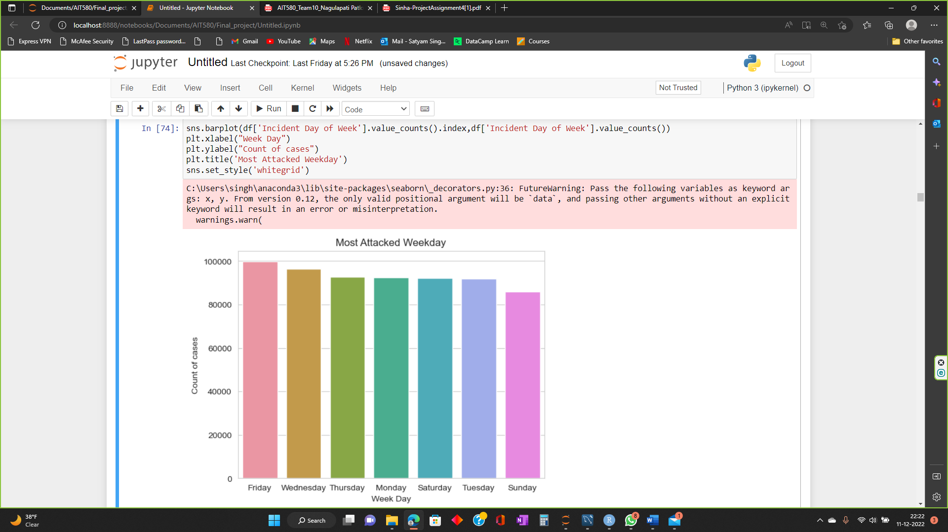
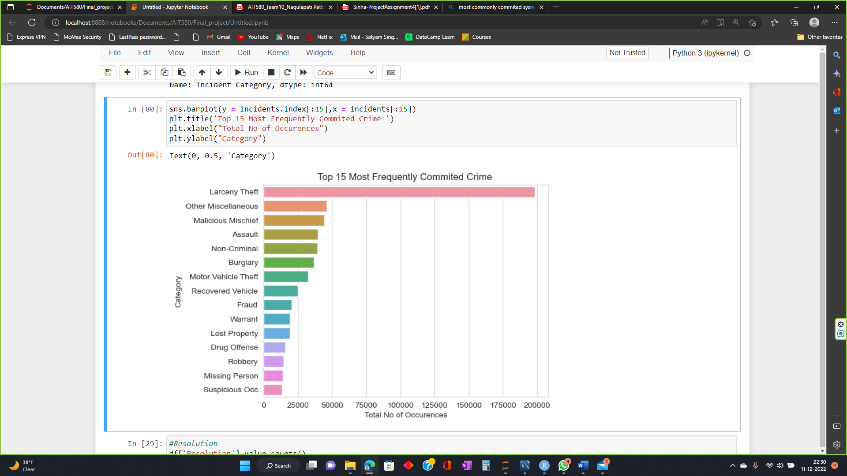
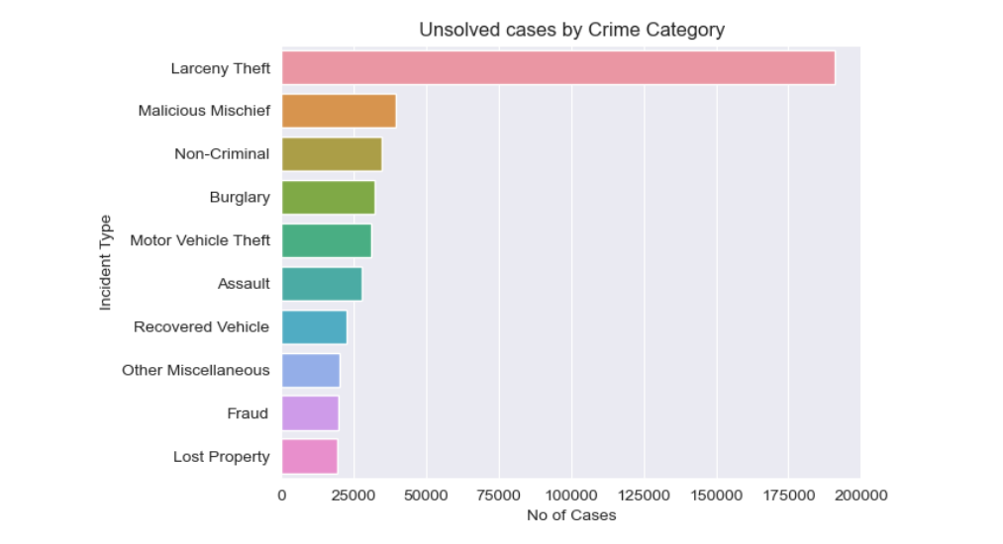
Graphs and Plots

Slide 6
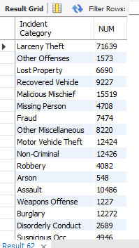
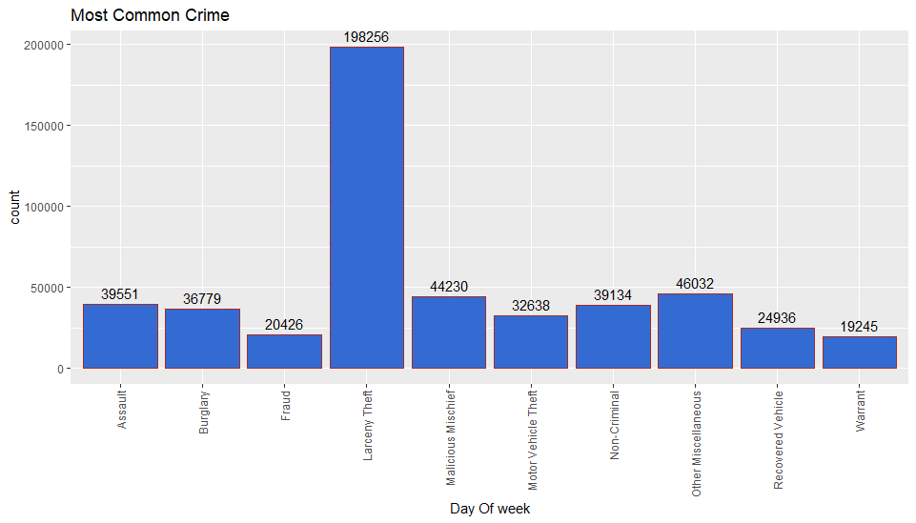
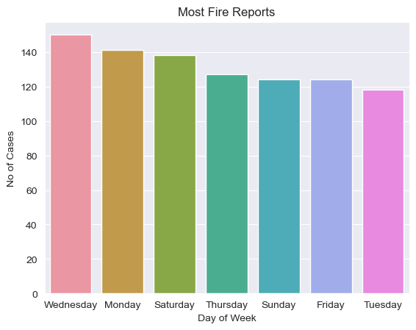
Graphs and plots

Slide 7
Result
After the in-depth analysis and deep digging through all the languages mentioned we have found some interesting patterns and statistics.
Theft is the most committed crime and is mostly left unsolved. I believe that theft being commonly committed and not getting solved is the reason why it is being committed so often. Criminals can think of this as an easy way out as the chances are they will escape the consequences.
Friday is one of the most dangerous day in San Francisco as it has the highest number of crimes committed on this day. Its obvious that on Weekends people go out for refreshment and social gatherings and this is understood by criminals who make citizens as their targets.
Various answers can be found if the right question is asked,

Slide 8
Learning
This Project has taught me many skills. I can now confidently analyze data and get meaningful information with Python, R and MySQL.
Data cleaning and preprocessing steps are extremely important as they are the base of the project, so all the conclusions depend upon their reliability.
Apart from these, Ive learnt how to find out important features in a dataset which can answer many questions.
Visualization is extremely useful as it can give us a good idea about the huge dataset in just one picture. Tables and manipulations are good but what a picture can explain is unmatched.
Patterns can be identified easily and thus we can expect similar behavior in certain areas. This identification can lead to answering many questions and is the baseline of Analysis.

Slide 9
References
Police Department Incident Reports: 2018 to Present | DataSF | City and County of San Francisco (sfgov.org)
https://wrlc-gm.primo.exlibrisgroup.com/permalink/01WRLC_GML/19u1omk/cdi_proquest_journals_2526965676
https://wrlc-gm.primo.exlibrisgroup.com/permalink/01WRLC_GML/19u1omk/cdi_crossref_primary_10_1016_j_procs_2018_05_075
https://wrlc-gm.primo.exlibrisgroup.com/permalink/01WRLC_GML/19u1omk/cdi_proquest_journals_1771058740
https://library.gmu.edu/
https://ohiostate.pressbooks.pub/engrtechcomm/chapter/strategies-for-conducting-research/
https://dsc.gmu.edu/
https://www3.nd.edu/~pkamat/pdf/graphs.pdf

